Slide 1
DECISION TREE

Slide 2
1. What is a Decision Tree
A Decision Tree is a supervised machine learning algorithm that models decisions using a tree-like structure, where:
Internal nodes represent feature-based conditions
Branches represent decision rules
Leaf nodes represent final predictions
It can be used for classification and regression.

Slide 3
2. Purpose
To make predictions by recursively splitting data into homogeneous subsets, mimicking human decision-making.
Used when:
Relationships are non-linear
Interpretability is important
Mixed data types exist (numerical + categorical)

Slide 4
3. Why it is Used
Easy to understand and visualize
Handles non-linear patterns naturally
No need for feature scaling
Works with missing values (some implementations)

Slide 5
4. How a Decision Tree Works (Algorithm)
Step-by-Step:
Start with the entire dataset at the root node
Select the best feature and split point
Split data into child nodes
Repeat recursively for each node
Stop when stopping criteria are met
Assign prediction at leaf nodes

Slide 6
5. Splitting Criteria (Core of Algorithm)
For Classification:
Gini Impurity
Gini=1−∑pi^2
Entropy
Entropy=−∑pilog⁡2(pi)
Information Gain
IG=Entropy(parent)−∑nk/nEntropy(childk)
For Regression:
Mean Squared Error (MSE)
Mean Absolute Error (MAE)
Variance Reduction

Slide 7
6. Types of Decision Trees
Based on Task:
Classification Tree
Regression Tree
Based on Algorithm:
ID3 (Entropy)
C4.5 (Entropy + Pruning)
CART (Gini / MSE)

Slide 8
7. Formula / Mathematical Representation
Prediction:
Classification → majority class in leaf
Regression → mean/median value in leaf
Variance Reduction:
VR=Var(parent)−∑nk/nVar(childk)

Slide 9
8. Technical Details
Assumptions:
No strict statistical assumptions
Works without linearity or normality
Stopping Criteria:
Max depth reached
Minimum samples per node
No further impurity reduction
Tree Growth:
Top-down, greedy algorithm
Locally optimal splits (not global)

Slide 10
9. Parameters
Model Parameters (Learned):
Tree structure
Split thresholds
Leaf values
Hyperparameters (Tuning):
max_depth
min_samples_split
min_samples_leaf
max_features
criterion (gini, entropy, mse)

Slide 11
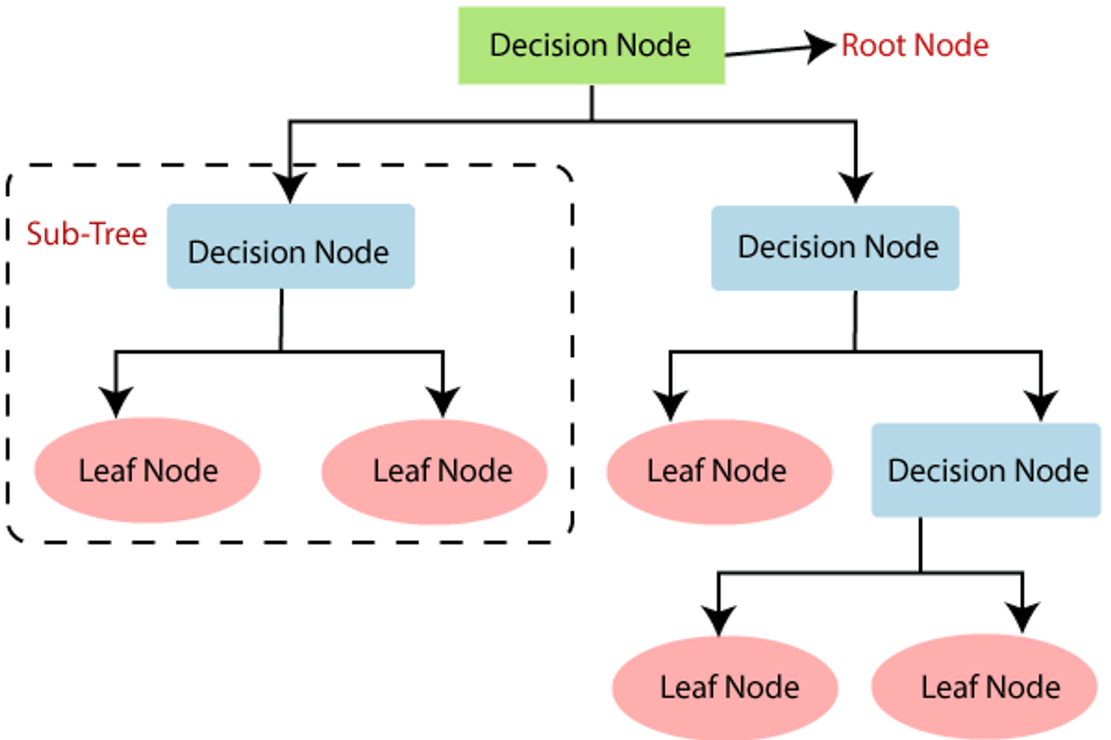

Slide 12
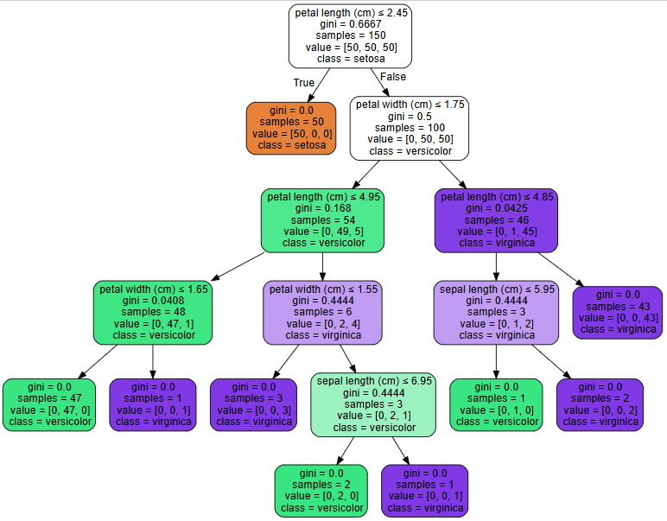

Slide 13
10. Pros
Highly interpretable
Handles non-linear data
Works with mixed feature types
No feature scaling required
Fast inference

Slide 14
11. Cons
Prone to overfitting
Unstable to small data changes
Greedy (locally optimal splits)
Poor generalization alone
Biased toward dominant features

Slide 15
12. Real-World Applications
Business:
Customer segmentation
Churn prediction
Finance:
Credit risk analysis
Loan approval systems
Healthcare:
Disease diagnosis
Treatment decision support
Engineering:
Fault detection systems
ML Systems:
Base learner in Random Forest, XGBoost, LightGBM

Slide 16
13. Comparison with Linear & Logistic Regression
Aspect | Decision Tree | Linear / Logistic
Relationship | Non-linear | Linear
Interpretability | High | Medium
Feature Scaling | Not required | Required
Overfitting | High | Moderate
Output | Class / Value | Value / Probability

Slide 17
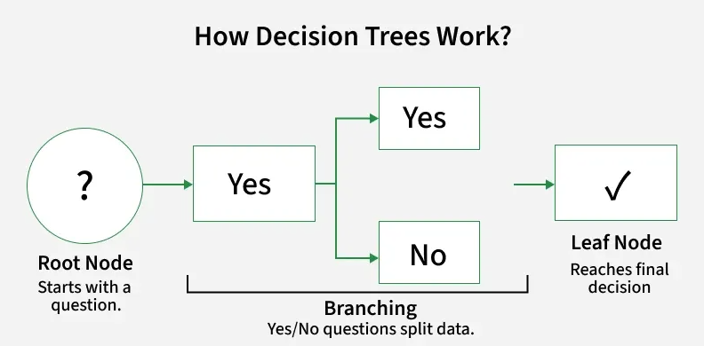
Summary
A Decision Tree is a rule-based, interpretable, non-parametric model that recursively splits data to make predictions.

